Slide 1
HEXA and Tay-Sachs Disease
Presented by: Yi Sin Tee
http://www.ldnz.org.nz/news_and_issues/conference_reports/national_tay_sachs_and_allied_diseases

Slide 2
Background on Tay-Sachs Disease (TSD)
Autosomal recessive disorder
Due to missing Hexoaminidase A (an enzyme that remove acetylglucosamine residues from polysaccharides)
Carrier rate: 1 in 300
Occurrence in Eastern European, Central European and Askhenazi Jewish heritage
Notes:
1. Tay-Sachs occurs when both parents carry a Tay-Sachs gene and each parent transmits the defective gene to their child.
2. The less Hex-A a person has, the faster waste builds up and the more severe the brain damage.
Hex A requires the assistance of an activator protein to make the lipophilic GM2 ganglioside accessible for hydrolysis in the hydrophilic environment of the lysosome.
absence hexosaminidase-A (Hex-A) which causes the fatty substance in the brain to build up into toxic levels, hence affecting the brains’ nerve cells.

Slide 3
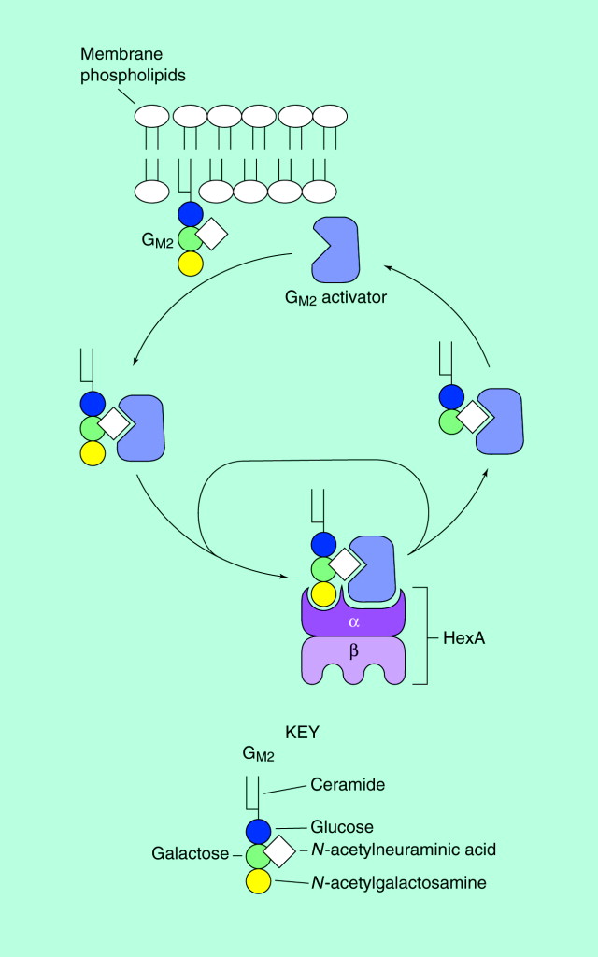
Model for the lysosomal metabolism of GM2
Hex A
- heterodimer
- interact with GM2 indirectly.
- Remove the terminal N-acetylgalactosamine from GM2
GM2 activator protein
Extracts the glycolipid
Activator-lipid complex
http://www.sciencedirect.com/science/article/pii/S1357431098012271
Notes:
(HexA) is a heterodimer composed of one a and one b chain. It does not interact directly with the membrane-bound GM2. Instead, the GM2 activator protein
extracts the glycolipid, and the resulting activator–lipid complex is the substrate for the enzymatic reaction catalyzed by HexA (removal of the terminal
N-acetylgalactosamine from GM2).

Slide 4
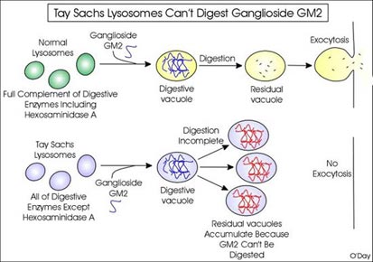
http://www.utm.utoronto.ca/~w3bio315/lecture15.htm
Notes:
In normal cells the turnover of ganglioside GM2 occurs regularly. Once inside digestive vacuoles the normal complement of enzymes breaks it down and the contents of the residual vacuole are exocytosed.
In Tay Sachs, the absence of Hexosaminidase A prevents complete digestion of the ganglioside GM2 because acetylglucosamine residues cannot be cleaved off. This results in the inability of the residual vacuoles to be exocytosed. Thus they continue to accumulate in the cytoplasm of the cell causing it to swell up.

Slide 5
Types of TSD
Information adapted from National Tay-Sachs & Allied Diseases

Slide 6
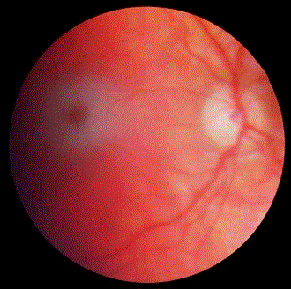
What are the symptoms of TSD?
Loss of muscle coordination
Speech problems
Seizures
Mental retardation
Paralysis
Dementia
Eye abnormality
→ cherry-red spot
Figure from http://flipper.diff.org/app/items/info/2950
Notes:
Treatments available can only help slow down the progress and make the affected individual feel more comfortable but cannot really reverse the effects of the illness.

Slide 7
Location of HEXA gene
Figure from Genetics Home Reference
Mutations of the HEXA gene reduce the activity of β-hexosaminidase A (Hex A)
Notes:
The gene that causes Tay-Sachs is located on chromosome 15.
The gene encoding the aipha subunit of b-hexosaminidase is designated HEXA in humans
Mutations of the HEXA gene reduce the activity of β-hexosaminidase A (Hex A). Deficiency of Hex A causes the buildup of GM2-ganglioside, which can causes the signs of TSD

Slide 8
HEXA protein domain
Two domains were found on the HEXA sequence by SMART.
Active site
Two domains were found in HEXA protein by Pfam.
Glycoside hydrolase family 20, domain 2
Glycoside hydrolase family 20, catalytic domain
Notes:
The green domain represents glycoside hydrolase family 20, domain 2. Pfam suggested that the location of this domain to be from 35 to 165.
Beta-hexosaminidase is one of the known enzymes in Glycoside hydrolase family 20.
- glycoside hydrolase – a group of enzymes that hydrolyse the glycosidic bond between two or more carbohydrates, or between a carbohydrate and a non-carbohydrate moiety.
In the brain and other tissues, beta-hexosaminidase A degrades GM2 gangliosides [3]. The red domain represents glycosyl hydrolase family 20, catalytic domain, with an e-value of 2e-84. This domain located between 167 and 487, which has a TIM barrel fold [2]. The purple diamond in the figure also indicates the Pfam predicted active site which is the residue E323. This pedicted active site is located at 323.
A 65% sequence homology between the a- and bchains at the DNA level suggest that both polypeptides evolved from a common ancestor.
Glycosidic cleavage at the a-chain catalytic site.

Slide 9
How is HEXA associated with TSD?
TSD is caused by a mutation that leaves the body unable to produce an enzyme known as hexosaminidase-A (Hex-A).
Fat metabolism in nerve cells.
By the absence of this enzyme, central nervous system degeneration ensues due to the accumulation of lipid called GM2 ganglioside in the nerve cells of the brain

Slide 10
How is HEXA associated with TSD?
TSD is caused by a mutation that leaves the body unable to produce an enzyme known as hexosaminidase-A (Hex-A).
Fat metabolism in nerve cells.
By the absence of this enzyme, central nervous system degeneration ensues due to the accumulation of lipid called GM2 ganglioside in the nerve cells of the brain

Slide 11
Organism Phenotypes
Hexa -/- mice show the neuropathology characteristic of Tay-Sachs disease.
Membranous cytoplasmic bodies (MCBs) in the parietal cortex.
Neurons are immunostained with anti-Gm2 ganglioside antibody.
Multilayered lamellae in a cerebral cortical neuron
http://www.ncbi.nlm.nih.gov/pmc/articles/PMC44940/pdf/pnas01143-0320.pdf
Notes:
Hexa -/- mice show the neuropathology characteristic of Tay-Sachs disease. (A)membranous cytoplasmic bodies (MCBs) are clearly recognized in the perikarya of two neurons in the parietal cortex from a Hexa -/- mouse. A 1-lm E (B) Many neurons are immunostained with anti-Gm2 ganglioside antibody in a 7-pam cryosection of the mamillary body from an8-month-old mouse. Note the dark peroxidase reaction product staining the neurons. Sections from control mice were totally negative for the reaction product. (x30.) (C) Electron micrograph of anMCB composed of multilayered lamellae in a cerebral cortical neuron from a 7-week-old Hexa -/- mouse. (x9500.)
There were no obvious storage cells in the heart, lung, thymus, liver, spleen, lymph nodes, pancreas, adrenal gland, kidney, and reproductive organs.
The distribution of storage neurons in mice appeared to be localized in certain regions.

Slide 12
Organism Phenotypes
Phenotype of Late Onset TSD (LOTS) mice.
The phenotype of a presymptomatic 8-month old bred female
A symptomatic 18-month-old bred female
Jeyakumar, M. , Smith, D. , Eliott-Smith, E. , Cortina-Borja, M. , Reinkensmeier, G. , et al. (2002). An inducible mouse model of late onset tay-sachs disease. Neurobiology of Disease, 10(3), 201-210
Notes:
the hind limbs were never brought forward to be adjacent to the previous position of the front paw
abdominal dragging

Slide 13
Why use a mouse model?
Human protein domain HEXA
Mouse protein domain Hexa
Identities = 84%
The mutant phenotypes expressed in the mice are the closest characteristics of the human Tay-Sachs disease.
Notes:
The mutant phenotypes expressed in the mice are the closest characteristics of the human Tay-Sachs disease.
- Brain and eyes
- TSD is not caused by a single type of mutation

Slide 14
Hexa Protein Phylogeny
Phylogenetic tree made using ClustalW2
Notes:
Chimpanzee (Pan troglodytes), dog (Canis lupus familiaris), cattle (Bos taurus), mouse (Mus musculus), rat (Rattus norvegicus), chicken (Gallus gallus), zebrafish (Danio rerio), and small flowering plant (Arabidopsis thaliana)

Slide 15
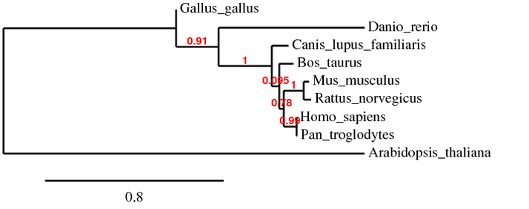
Hexa Protein Phylogeny
Phylogenetic tree made using Phylogeny.fr

Slide 16
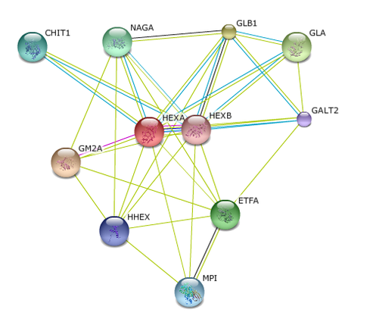
HEXA Interaction Network
http://string.embl.de/newstring_cgi/show_network_section.pl

Slide 17
Experimental Questions
What is the Gene Ontology (GO) for the proteins involved in the degradation of GM2 in the HEXA interaction network?
What domain are found in the related proteins located at the lysosome? Are Glycoside hydrolase family 20, catalytic domain found in those protein?
Notes:
Formation of a ternary complex between GM2 activator protein, GM2 ganglioside and hexosaminidase A
The ganglioside is stored in the form of concentrically arranged lamellae known as membranous cytoplasmic
bodies (MCBs).

Slide 18
Experimental Questions
What is the Gene Ontology (GO) for the proteins involved in the degradation of GM2 in the HEXA interaction network?
What domain are found in the related proteins located at the lysosome? Are Glycoside hydrolase family 20, catalytic domain found in those protein?
Notes:
Formation of a ternary complex between GM2 activator protein, GM2 ganglioside and hexosaminidase A
The ganglioside is stored in the form of concentrically arranged lamellae known as membranous cytoplasmic
bodies (MCBs).

Slide 19
(1) What is the GO for the proteins involved in the degradation of GM2 in the HEXA interaction network?
Method: Using the AMIGO database to find out the gene ontology of each related proteins in the degradation of GM2 and categorize them into different cellular component.
Notes:
Formation of a ternary complex between GM(2) activator protein, GM(2) ganglioside and hexosaminidase A
Structural Analysis of Lipid Complexes of GM2-Activator Protein
How does GM2-AP recognize Hex-A

Slide 20
(1) Hypothesis
The GO for the related proteins in the HEXA interaction network is categorized based on cellular component. There are categorized into groups like lysosome, lysosomal lumen, membrane, nucleus, cytosol, Golgi apparatus, and mitochondrial matrix.

Slide 21
(1) Collected Data
Lysosomal lumen
lysosome
Golgi apparatus
Mitochondrial matrix
Nucleus
Cytosol
http://string.embl.de/newstring_cgi/show_network_section.pl
Notes:
HEXA protein has important roles in ganglioside catabolic process (biological process) and beta-N-acetylhexosaminidase activity (molecular function).
Cellular component HEXA: lysosomal lumen, membrane

Slide 22
Experimental Questions
What is the Gene Ontology (GO) for the proteins involved in the degradation of GM2 in the HEXA interaction network?
What domain are found in the related proteins located at the lysosome? Are Glycoside hydrolase family 20, catalytic domain found in those protein?
Notes:
Formation of a ternary complex between GM2 activator protein, GM2 ganglioside and hexosaminidase A
The ganglioside is stored in the form of concentrically arranged lamellae known as membranous cytoplasmic
bodies (MCBs).

Slide 23
(2) What domain are found in the related proteins located at the lysosome?
- Are Glycoside hydrolase family 20, catalytic domain found in those protein?
Method: Using the SMART database to find the domains of the related proteins that are located in the lysosome.

Slide 24
(2) Hypothesis
The Glycoside hydrolase family, catalytic domain should be observed in some of the proteins located at the lysosome in the HEXA interaction network because this domain play an important role in degrading GM2 ganglioside.
Notes:
Share the same protein domain

Slide 25
(2) Collected Data
HEXA
HEXB
CHIT1
GLB1
Notes:
ML (MD-2-related lipid-recognition) - Domain involved in innate immunity and lipid metabolism.
GLB1 - Due to overlapping domains, there are 2 representations of the protein

Slide 26
(2) Expected Data
NAGA
Melibiase
GM2A
Notes:
NAGA - Melibiase domain - Alpha-galactosidase (melibiase) [(PUBMED:4561015)] catalyzes the hydrolysis of melibiose into galactose and glucose.
Cht- chitin binding domain - Degrades chitin (long-chain polymer of a N-acetylglucosamine) and chitotriose.

Slide 27
Model for the lysosomal metabolism of GM2
Hex A
- heterodimer
- interact with GM2 indirectly.
- Remove the terminal N-acetylgalactosamine from GM2
GM2 activator protein
Extracts the glycolipid
Activator-lipid complex
http://www.sciencedirect.com/science/article/pii/S1357431098012271
Notes:
(HexA) is a heterodimer composed of one a and one b chain. It does not interact directly with the membrane-bound GM2. Instead, the GM2 activator protein
extracts the glycolipid, and the resulting activator–lipid complex is the substrate for the enzymatic reaction catalyzed by HexA (removal of the terminal
N-acetylgalactosamine from GM2).

Slide 28
Future Directions
What mechanism of action of GM2-AP causes the recognition of Hex-A?
Method: TAP-tag
→ Label GM2-AP and determine how it is recognize HEXA
2. Chaperone Therapy
Different kind of chaperone to treat TSD with different mutant variations.
3. To create effective GM2 ganglioside inhibitors.

Slide 29
Conclusion
Tay-Sachs Disease (TSD) is an autosomal recessive disease caused by mutations in both alleles of a gene (HEXA) on chromosome 15.
The Glycoside hydrolase family 20, catalytic domain could play an important role in degrading GM2 ganglioside.

Slide 31
References
Jeyakumar, M. , Smith, D. , Eliott-Smith, E. , Cortina-Borja, M. , Reinkensmeier, G. , et al. (2002). An inducible mouse model of late onset tay-sachs disease. Neurobiology of Disease, 10(3), 201-210.
Kabir, M. , Qadir, S. , Hassan, S. , Ahn, J. , & Wang, M. (4784). Rnai: An emerging field of molecular research. African Journal of Biotechnology, 7(25), 4784-4788. From http://www.ajol.info/index.php/ajb/article/viewFile/59671/47957
MGI
Yamanaka, S. , Johnson, M. , Grinberg, A. , Westphal, H. , Crawley, J. , et al. (1994). Targeted disruption of the hexa gene results in mice with biochemical and pathologic features of tay-sachs disease. Proceedings of the National Academy of Sciences of the United States of America, 91(21), 9975-9979. [PUBMED]
National Tay-Sachs & Allied Diseases
String: http://string.embl.de
SMART: http://smart.embl-heidelberg.de/
PFAM:http://pfam.sanger.ac.uk/

Slide 32
Video
http://www.cbs42.com/content/localnews/story/Little-Girl-Gets-Stem-Cell-Treatment-For-Deadly/goY5hrZWkkS7yfOENWxsdA.cspx

